Slide 1
Verification and Validation of the General Mission Analysis Tool (GMAT)
S. Hughes
Aug, 8 2014
NASA Goddard Space Flight Center

Slide 2
Intro And V&V overview

Slide 3
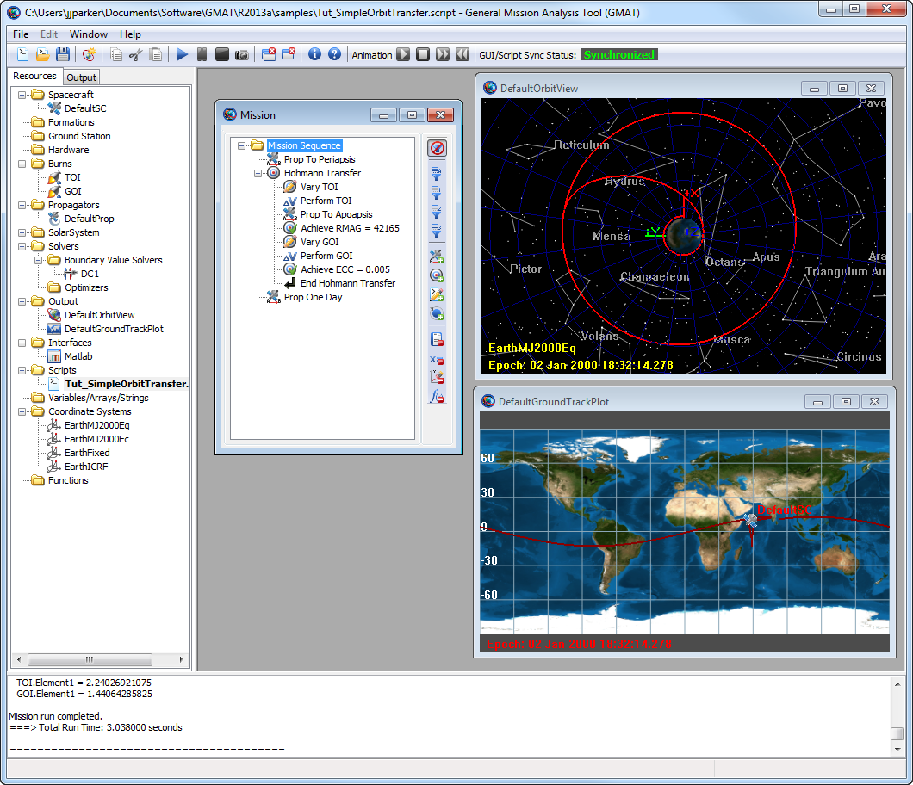
What is GMAT?
GMAT is a general mission design and analysis tool.
Key Applications:
Mission analysis/optimization
All orbital regimes
Key characteristics:
open source
high fidelity
feature rich
desktop oriented
Status: Fully tested and flight qualified

Slide 4
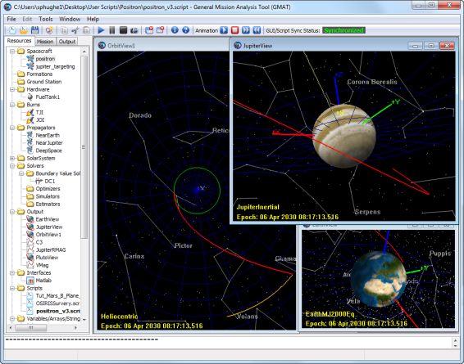
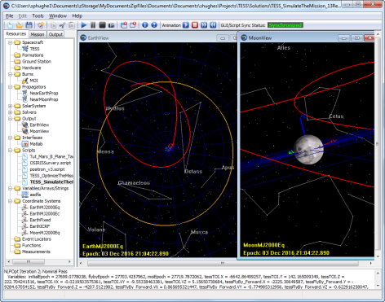
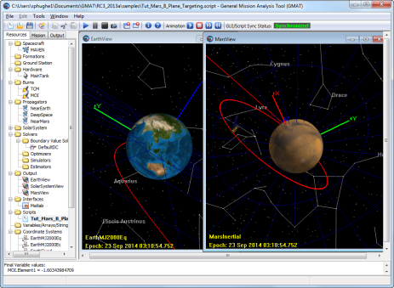
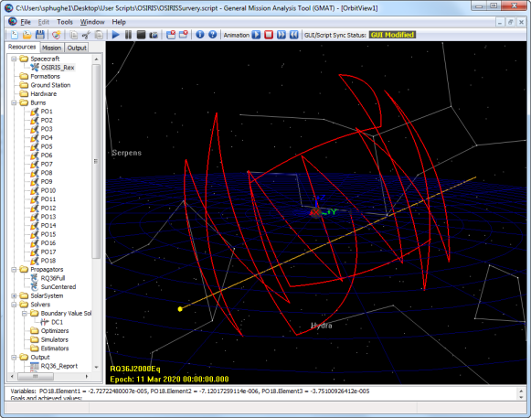
Customizable Tools to Go Anywhere
Customizable trajectory solutions to go anywhere
LEO
Libration
Lunar
NEO
Interplanetary
End-to-End Support
Design the mission
Optimize the mission
Win the proposal
Fly the mission
Optimal Lunar Flyby
Outer Planet Transfers
Optimal Mars Trajectories
Download and find out more: gmatcentral.org
Asteroid (RQ36) Survey

Slide 5
Goals of the V&V Effort
Technical Goals
Systematically evaluate and validate all models, components, and functionality
Fix all critical system defects
Update working specifications that define system behavior
Provide high quality end user documentation and training material
Prepare for system maintenance and further development of a Class B flight qualified system
Strategic goals
Position GMAT for larger community adoption
Position GMAT for flight qualification to begin in the spring of 2013.

Slide 6
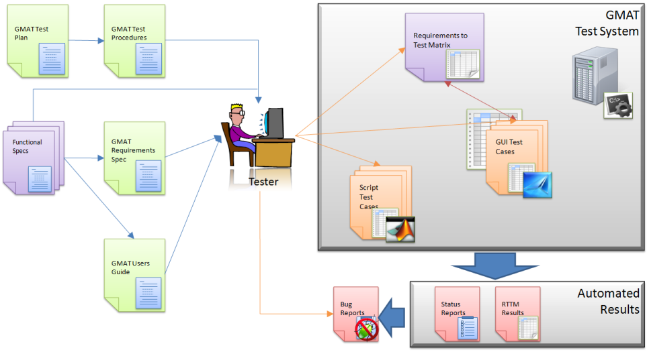
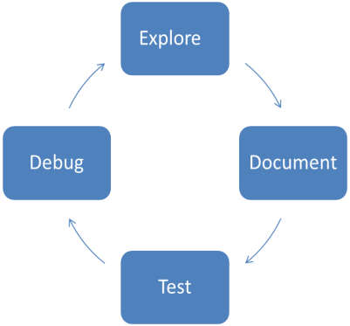
V&V Philosophy and Environment
Our V&V Philosophy
Test Summary
Produced about 13000 script tests
Produced about 3500 GUI tests
Regression Testing
Script tests run nightly for regression
GUI tests run weekly
Our Test Environment

Slide 7
Test Types and Component Breakdown
Test Type | Description
Numeric Tests | Tests of physical and mathematical models. Numeric tests are performed by comparing output to external "truth".
Functional tests | Tests that verify non-numeric functionality, such as plotting styles, file formats, and control flow behavior.
Input validation | Tests that ensure user inputs are validated by the system and the correct error messages are provided for invalid user input.
End-to-end tests | Tests that solve an end-to-end engineering problem such as a lunar transfer or orbital maneuver. These tests are "fit for use" tests and are applications of GMAT to real-world problems
Stress Tests | Test designed to stress the system and make heavy use of system resources.
Edge corner tests | Tests designed to test models at the boundaries of applicability, in the GMAT context this often means testing models near numerical singularities.
We performed standard test types

Slide 8
Component Breakdown
Component Area | Description/Features
Dynamics/Models | Numerical models for orbit and attitude propagation, solar system and coordinate system models including spacecraft orbit state representations, spacecraft ballistic and mass properties, etc.
Powered Flight | Impulsive and finite maneuvering including tanks, thrusters, impulsive maneuver, finite maneuver
Solver Infrastructure | Algorithms and infrastructure for solving boundary value and optimization problems.
Programming Infrastructure | Algorithms and features for customization including custom scripting, user defined variables and arrays, scripted custom equations, built-in astrodynamic computations, control flow, and external interfaces.
Output\Utils | Components to support graphical and data output such as xy-plots, 3-D graphics, report files, and ephemeris files.
Application Control | Inherently interface elements such as file menus, command line interfaces, and the script editor.
Components were tested in logical groups.

Slide 9
Dynamics and Modelling

Slide 10
Orbit Propagation Comparison: Individual Force Modeling
 | Dynamics Model
Orbital Regime | Spherical Gravity | Harmonic gravity | Tides | Point mass perturbation | SRP | MSISE90 | NRLMSISE00 | Jacchia-Roberts | Relativistic Correction
ISS | 7.1E-06 | 2.5E-03 | 3.3E-01 | 1.5E-05 | 1.3E-01 | 1.8E-01 | 1.1E+00 | 1.9E+00 | 3.8E-02
Sun Sync | 3.9E-05 | 5.0E-04 | 5.7E-01 | 3.6E-05 | 1.7E-01 | 1.8E-02 | 5.8E+00 | 2.0E+00 | x
GPS | 2.7E-06 | 1.5E-04 | 2.5E-02 | 2.3E-05 | 4.7E-02 | 1.4E-05 | 4.2E-06 | 2.7E-06 | x
GEO | 6.3E-06 | 2.8E-05 | 5.0E-02 | 1.8E-04 | 2.4E-05 | 6.3E-06 | 5.2E-05 | 6.3E-06 | 2.3E-03
Molniya | 2.4E-04 | 6.1E-03 | 6.0E+00 | 2.0E-04 | 5.8E-01 | 1.8E-03 | 4.3E+00 | 1.3E-01 | x
Luna | 7.3E-05 | 1.9E-04 | N/A | 2.2E-04 | 1.1E-04 | N/A | N/A | N/A | x
Venus | 9.0E-03 | 1.1E-02 | N/A | 1.4E-02 | 3.7E-02 | N/A | N/A | N/A | x
Mars | 6.1E-02 | 1.2E-01 | N/A | 3.2E-01 | 6.0E-01 | N/A | N/A | N/A | x

Slide 11
Orbit Propagation Comparison: Combined Force Modeling
Test Case ID | Max Position Diff. RSS (m)
GEO (TBPM,HG,Drag,SRP,Tide) | 9.2227E-01
GEO (TBPM,HG,Drag,SRP) | 1.7184E-04
GPS (TBPM,HG,Drag,SRP,Tide) | 5.2289E-01
GPS (TBPM,HG,Drag,SRP) | 7.5020E-02
ISS (TBPM,HG,Drag,SRP,Tide) | 1.9932E+00
ISS (TBPM,HG,Drag,SRP) | 1.6639E+00
Molniya (TBPM,HG,Drag,SRP) | 5.1301E-01
SunSync (TBPM,HG,Drag,SRP) | 3.3214E-01
Lunar Transfer (TBPM, HG, SRP) | 8.6480E-01
Mars Transfer (TBPM, HG, SRP) | 5.2626E+00
Asteroid (TBPM, HG, SRP) | 4.6731E-03
Earth Moon L2 (TBPM, SRP) | 8.0749E-01
Deep Space (TBPM, Rel) | 3.8275E-02
Titan(TBPM, SRP) | 2.5002E-01
Software | Harm. Gravity | Point Mass | SRP | Drag
GTDS | 0.07 | 0.06 | 2.50 | 575.00
TRACE | 0.0020 | 0.02 | 1.50 | 750.00
Special K | N/A | 0.07 | N/A | N/A
GMAT | 0.01 | 0.0002 | 0.58 | 5.77
GEODYN | N/A | N/A | N/A | 1000
Worst Case Comparisons Across Industry Standard Tools. GMAT Compares Very Well.
Meter or better agreement for full force modelling

Slide 12
Integrator Closure Tests
Orbit | Data | RKV89 | RKN68 | RK56 | PD45 | PD78 | ABM
ISS | Run Time | 1.53 | 1.00 | 2.14 | 2.78 | 1.46 | 3.41
 | Error (m) | 0.003 | 64.060 | 0.022 | 0.002 | 0.006 | 0.012
Molniya | Run Time | 1.32 | 1.47 | 1.99 | 3.08 | 1.00 | 3.35
 | Error (m) | 0.007 | 0.601 | 0.059 | 0.032 | 0.043 | 380.125
Lunar Flyby | Run Time | 1.00 | 1.01 | 2.26 | 2.98 | 2.21 | 3.30
 | Error (m) | 0.063 | 0.017 | 0.002 | 0.023 | 0.000 | 0.236
Mars Transfer | Run Time | 1.02 | 1.04 | 1.14 | 1.40 | 1.00 | 3.07
 | Error (m) | 0.030 | 0.001 | 0.043 | 0.194 | 0.009 | 25.231
Finite burn 1 | Run Time | 1.27 | N/A | 1.24 | 1.26 | 1.00 | 1.45
 | Error (m) | 0.002 | N/A | 0.006 | 0.002 | 0.002 | 0.000
Finite burn 2 | Run Time | 1.03 | N/A | 1.18 | 1.31 | 1.00 | 1.54
 | Error (m) | 0.002 | N/A | 0.000 | 0.000 | 0.001 | 0.003
Prince Dormand 78 is Best General Purpose Integrator Available

Slide 13
Coordinate System Tests
Conversion Type | Position Comparison |  | Velocity Comparison
 | RSS Diff (m) | Angle Diff (deg.) | RSS Diff (m/s) | Angle Diff (deg.)
FK5 To BodyFixed | 5.79E-03 | 4.88E-08 | 5.65E-06 | 4.23E-08
FK5 To BodySpinSun | 2.17E-04 | 1.83E-09 | 1.35E-07 | 1.01E-09
FK5 To GSE | 1.11E-05 | 9.36E-11 | 1.22E-08 | 9.14E-11
FK5 To GSM | 2.13E-04 | 1.79E-09 | 3.66E-06 | 2.74E-08
FK5 To ICRF | 7.80E-03 | 6.57E-08 | 1.97E-06 | 1.47E-08
FK5 To MJ2000Ec | 9.19E-05 | 7.74E-10 | 1.05E-07 | 7.84E-10
FK5 To MJ2000Eq | 0.00E+00 | 0.00E+00 | 6.39E-12 | 4.78E-14
FK5 To MODEc | 3.33E-07 | 2.80E-12 | 2.31E-11 | 1.73E-13
FK5 To MODEq | 9.37E-10 | 7.90E-15 | 6.53E-12 | 4.89E-14
FK5 To MOEEc | 6.75E-09 | 5.69E-14 | 5.42E-12 | 4.06E-14
FK5 To MOEEq | 4.90E-09 | 4.13E-14 | 6.14E-12 | 4.59E-14
FK5 To ObjectReferenced | 1.11E-05 | 9.36E-11 | 1.22E-08 | 9.14E-11
FK5 To TODEc | 2.00E-04 | 1.69E-09 | 2.20E-07 | 1.65E-09
FK5 To TODEq | 1.98E-04 | 1.67E-09 | 2.38E-07 | 1.78E-09
FK5 To TOEEc | 6.55E-05 | 5.52E-10 | 7.20E-08 | 5.39E-10
FK5 To TOEEq | 2.05E-04 | 1.72E-09 | 2.57E-07 | 1.92E-09
FK5 To Topocentric | 5.92E-03 | 4.99E-08 | 5.68E-06 | 4.25E-08
Excellent Agreement for All Transformations

Slide 14
Powered Flight

Slide 15
Example Tank Configuration
Tank | Description | Mass (kg) | Pressure (kPa) | Temp (C) | Ref Temp (C) | Volume (m³) | Fuel Density (kg/m³) | Pressure Model
A | Baseline | 725 | 1200 | 20 | 12 | 0.8 | 1029 | PR
B | High Mass | 820 | 1200 | 20 | 12 | 0.8 | 1029 | PR
C | High Pressure | 725 | 2500 | 20 | 12 | 0.8 | 1029 | PR
D | Low Pressure | 725 | 725 | 20 | 12 | 0.8 | 1029 | PR
E | High Temp | 725 | 1200 | 200 | 12 | 0.8 | 1029 | PR
F | Low Temp | 725 | 1200 | 2 | 12 | 0.8 | 1029 | PR
G | High Ref Temp | 725 | 1200 | 20 | 100 | 0.8 | 1029 | PR
H | Low Ref Temp | 725 | 1200 | 20 | 2 | 0.8 | 1029 | PR
T | High Volume | 725 | 1200 | 20 | 12 | 80 | 1029 | BD
U | Low Density | 725 | 1200 | 20 | 12 | 8.0 | 101.325 | BD
V | High Density | 725 | 1200 | 20 | 12 | 0.8 | 2500 | BD

Slide 16
Example Thruster Configurations
Coordinate System | Designation | Description
MJ2000Eq | CS0 | J2000-based Earth-centered Earth mean equator inertial
Earth VNB | CS1 | Earth Velocity-Normal-Binormal (VNB) is a non-inertial coordinate system based upon the motion of the spacecraft with respect to the Earth. The X-axis of this coordinate system is along the velocity of the spacecraft with respect to the Earth, the Y-axis is along the instantaneous orbit normal (with respect to the Earth) of the spacecraft, and the Z-axis completes the right-handed set.
Earth LVLH | CS2 | Earth Local Vertical Local Horizontal (LVLH) is a non-inertial coordinate system based upon the motion of the spacecraft with respect to the Earth. The X-axis of this coordinate system is the position of the spacecraft with respect to the Earth, the Z-axis is the instantaneous orbit normal (with respect to the Earth) of the spacecraft, and the Y-axis completes the right-handed set.
SpacecraftBody | CS3 | SpacecraftBody is the attitude system of the spacecraft. Since the thrust is applied in this system, GMAT uses the attitude of the spacecraft, a spacecraft attribute, to determine the inertial thrust direction.
Custom Designed Earth VNB | CS4 | Same coordinate system as Earth VNB. (created using a different user interface)

Slide 17
Summary of Impulsive Maneuver Results
Orbit | Position RSS Error (m) | Velocity RSS Error (m/s) | Mass Error (g)
Earth | 0 | 0 | 2.27374E-10
Moon | 2.59206E-08 | 0 | 2.27374E-10
Mars | 5.96083E-06 | 1.7764E-12 | 2.27374E-10
Coordinate System | Position RSS Error (m) | Velocity RSS Error (m/s) | Mass Error (g)
Earth Mean Equator J2000 (CS0) | 0 | 0 | 2.27374E-10
Earth VNB (CS1) | 0 | 0 | 2.27374E-10
Earth LVLH (CS2) | 0 | 0 | 2.27374E-10
SpacecraftBody (CS3) | 0 | 0 | 2.27374E-10
Custom Designed Earth VNB (CS4) | 0 | 0 | 2.27374E-10
Test Category | Position RSS Error (m) |  | Velocity RSS Error (m/s) |  | Mass Error (g)
 | Low | High | Low | High | Low | High
Orbit | 0 | 6.0e-6 | 0 | 1.8e-12 | 2.3e-10 | 2.3e-10
Maneuver Coordinate System | 0 | 0 | 0 | 0 | 2.3e-10 | 2.3e-10
Tank Configuration | 0 | 0 | 0 | 0 | 0 | 2.3e-10
All | 0 | 6.0e-6 | 0 | 1.8e-12 | 0 | 2.3e-10

Slide 18
Summary of Finite Maneuver Results
Orbit | Position RSS Error (m) | Velocity RSS Error (m/s) | Mass Error (g)
Earth | 2.644E-03 | 3.415E-06 | 1.547E-05
Jupiter | 2.170E-02 | 1.066E-05 | 2.593E-05
Luna | 1.054E-02 | 3.728E-05 | 8.752E-05
Mars | 1.222E-03 | 1.195E-06 | 2.009E-05
Mercury | 1.129E-03 | 2.450E-06 | 1.097E-05
Neptune | 2.791E-02 | 1.720E-05 | 2.417E-05
Pluto | 5.000E-02 | 7.739E-04 | 1.098E-04
Saturn | 1.877E-03 | 6.404E-07 | 3.369E-06
Uranus | 7.388E-03 | 4.442E-06 | 1.211E-05
Venus | 1.198E-03 | 1.553E-06 | 5.555E-06
Thruster Configuration | Position RSS Error (m) | Velocity RSS Error (m/s) | Mass Error (g)
A | 2.644E-03 | 3.415E-06 | 1.547E-05
B | 1.940E-03 | 2.421E-06 | 1.147E-05
C | 7.279E-04 | 7.070E-07 | 5.189E-07
D | 3.004E-03 | 2.922E-06 | 2.145E-05
E | 5.000E-03 | 6.436E-06 | 2.371E-05
F | 1.135E-03 | 1.080E-06 | 2.938E-07
H | 2.993E-04 | 3.802E-07 | 2.728E-08

Slide 19
Output/Reporting

Slide 20
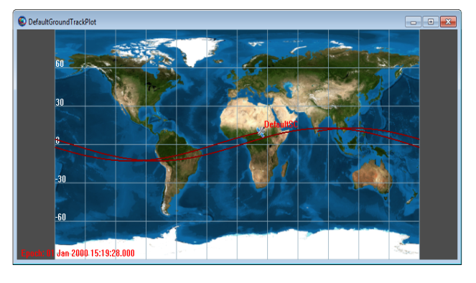
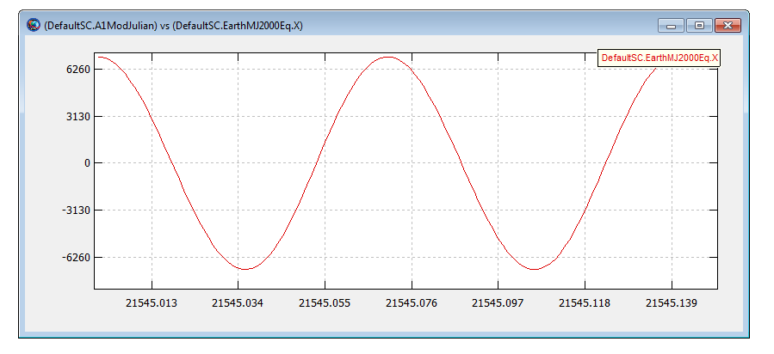
2-D Graphics: Ground Track & XY Plot
V&V testing methodology for Ground Track Plot employed standard GMAT GUI testing plans/procedures:
Testing involved visual inspection of each functional element
Compared graphical output to expected results from external tools
Prepared data for automated GUI regression tests that are run
using the GUI regression test environment
V&V testing methodology for XY Plot:
Initial testing involved visual inspection of all XY plot functional elements
Compared XY Plot output with MATLAB as the external benchmark tool
Equivalent XY data plots generated in MATLAB and GMAT and overlaid
plots for visual comparison
For more rigorous & automated GUI testing, test scripts were
written to test each XY plot element. Test scripts are used by
the GUI regression test environment

Slide 21
Output/Utilities Methodology and Results
Extensive & Systematic testing of all components in Output/Utilities feature area was done:
OrbitView
Spacecraft Visualization
GroundTrackPlot
XYPlot
ReportFile
EphemerisFile
Report
Toggle On/Off
ClearPlot
MarkPoint
PenUp & PenDown
Only test results for 2-D, 3-D graphics and Ephemeris File are presented

Slide 22
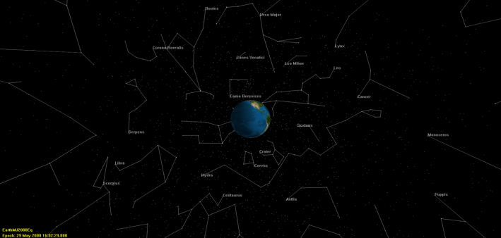
3-D Graphics
V&V testing for Orbit View:
Preliminary testing involved visual inspection of all 3-D graphics behavior
Key elements of GMAT’s graphics were compared against STK and Celestia benchmarks
GMAT & STK Comparison showing spacecraft trajectory,
ecliptic plane, xy plane and sun-centered MJ2000Eq coordinate sys.
GMAT & Celestia showing star constellations comparison

Slide 23
Ephemeris File
V&V testing methodology for EphemerisFile:
Extensive automated testing of ephemeris file component was conducted through GMAT’s script test system
Test scripts for all functional elements were written
For CCSDS ephemeris format, we compared interpolation to MATLAB and STK implementations
For SPK ephemeris format, we tested SPK ephemeris output comparing the results to STK and MICE toolbox

Slide 24
Programming Infrastructure

Slide 25
Programming Infrastructure
Two testing areas
Script Language: functional testing
Variables, arrays
Assignment, mathematics
Control flow, logical operators
External interfaces
Mission Data Parameters: numeric testing

Slide 26
Script Language
All features were tested with all applicable input and output types:
literals: numeric, strings
resources: variables, arrays, array elements, string variables, calculated parameters
mathematical expressions
Special testing for:
Logical operators: all data types w/ all operators
MATLAB interface: all data types as input/output
Mathematical expressions

Slide 27
Mathematical Expressions
Same syntax as MATLAB expressions
Wrote random generator to generate thousands of valid expressions
Results validated against MATLAB
100 scripts w/ random contents in regression system
Operators | Functions
+ (addition) | sin
- (subtraction) | cos
* (multiplication) | tan
/ (division) | asin
' (transpose) | acos
^ (power) | atan
 | atan2
 | log
 | log10
Example Operators and Functions

Slide 28
Mission Data Parameters
Parameters are calculated on request
Can be read-only or read-write
One of three types:
Standalone
Central-body dependency
Coordinate system dependency
Truth sources:
STK
custom MATLAB
custom GMAT scripting
Parameter | Access |  | Dependency
Spacecraft
Cartesian position | RW | Coordinate system
Keplerian elements | RW | Coordinate system, celestial body
Epoch | RW | (None)
Attitude quaternion | RW | (None)
Duty cycle | RW | (None)
Thrust scale factor
Fuel tank
Fuel mass | RW | (None)
Fuel density
Impulsive maneuver
Cartesian maneuver direction | RW | (None)
Example Parameters

Slide 29
Results: Central-Body Parameters
Orbit | Celestial body | Altitude (AST) | Beta angle (cust. GMAT) | Orbit energy (cust. AST) | Mean motion (cust. AST) | Angular momentum (AST) | Velocity at periapsis (cust. AST)
GEO | Earth | 5e-12 | < 1e-16 |  | 5e-14 | 8e-12 | 2e-11
 | Venus | 2e-12 | 2e-12 | 8e-11 | 6e-14 | 2e-11 | 4e-11
Hyperbolic | Earth | 3e-9 | 7e-15 | 6e-8 | 2e-11 | 2e-7 | 9e-8
 | Venus | 2e-11 | 3e-14 | 3e-8 | 1e-8 | 2e-8 | 2e-8
Mars | Earth | 2e-12 | < 1e-16 | 3e-9 | 4e-9 | 2e-9 | 2e-9
 | Mars | 4e-8 | < 1e-16 | 2e-9 | 2e-12 | 5e-10 | 5e-10
Luna | Earth | 2e-11 | < 1e-16 | 5e-8 | 3e-14 | 9e-9 | 9e-9
 | Luna | 3e-9 | < 1e-16 | 7e-10 | 6e-13 | 4e-10 | 4e-10

Slide 30
Results: Coordinate-System Parameters
Orbit | Coordinate system | Velocity magnitude | RAAN | Declination | Right ascension of velocity | Right ascension of hyperbolic asymptote | Declination of hyperblic asymptote
GEO | Earth J2000 | 4e-12 | 5e-14 | 5e-14 | 2e-9
 | Saturn Fixed | 8e-12 | 2e-5 | 8e-13 | 2e-5
Hyperbolic | Earth J2000 | 3e-8 | 1e-13 | 4e-9 | 4e-9
 | Saturn Fixed | 6e-13 | 2e-6 | 7e-13 | 2e-5
Hyperbolic2 | Earth J2000 |  |  |  |  | 7e-8 | 3e-8
 | Saturn Fixed |  |  |  |  | 7e-8 | 4e-8
Mars | Mars J2000 | 5e-9 | 2e-11 | 2e-5 | 9e-7
 | Saturn Fixed | 6e-13 | 6e-6 | 3e-13 | 6e-6
Luna | Moon J2000 | 5e-10 | 6e-13 | 2e-6 | 3e-7
 | Saturn Fixed | 4e-13 | 3e-6 | 4e-13 | 2e-5

Slide 31
GUI Testing

Slide 32
Goals of GUI Testing
Reasonable Confidence that GMAT is user-ready
100% Coverage of GUI – Every widget in the GUI gets exercised at least once
100% Requirements Fulfillment – Every GUI-related requirement is fulfilled by the GUI
Repeatable
Maintainable
The GMAT project uses SmartBear Software’s TestComplete to perform automated GUI testing on Windows platforms. TestComplete allows users to easily create, maintain, and execute automated tests for exercising the widgets of their GUI. It allows the GMAT GUI Test Team to perform functional and regression testing of the GMAT GUI.

Slide 33

GMAT Test Processes

Slide 34
GUI System Tests and “Unit” Tests
Unit tests ensure verification and acceptance testing of every button, menu, text box, etc.
One unit test project <-> one object (resource, command, script window, mission sequence, etc)
System tests validates the GMAT GUI by testing the entire application
End-to-end test cases
Simulating typical end-user interactions
Test Report History

Slide 35
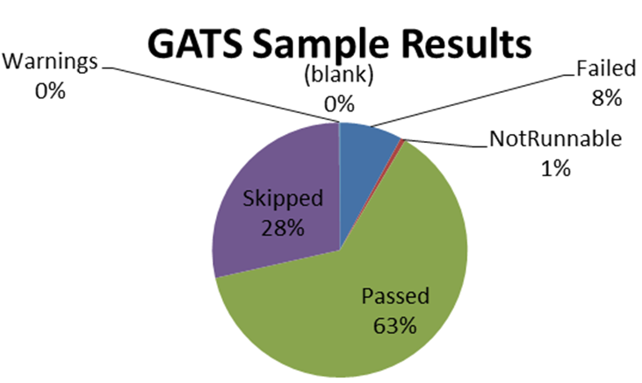
GATS and Requirements To Test Matrix
GMAT Automated Test Suite (GATS) tool executes RTTM
Automate the execution of the GUI tests
Map tests to requirements
Report results
In January 2012, it took approximately 14 days to manually execute and analyze 53 Unit test projects (totaling approximately 1000 tests). By March 2013, GATS was autonomously executing 90 GUI unit test projects (totaling approximately 3400 tests) in 4 days, requiring only 1-2 days of manual analysis (a 10x reduction in effort while providing 3.4x the coverage).

Slide 36
Conclusions

Slide 37
Conclusions
Systematically evaluated and validated all models, components, and functionality
Fixed nearly all critical system defects
Updated working specifications that define system behavior
Provided high quality end user documentation and training material
Prepared for system maintenance and further development of a NASA Class B flight qualified system
Positioned GMAT for larger community adoption
Positioned GMAT for flight qualification
Led to a smooth follow-on effort for flight qualification.

